Slide 1




2024 Value Investment Proposal Competition
Team 39
Chak Ming Sin
Ngo Yin Wong

Slide 2
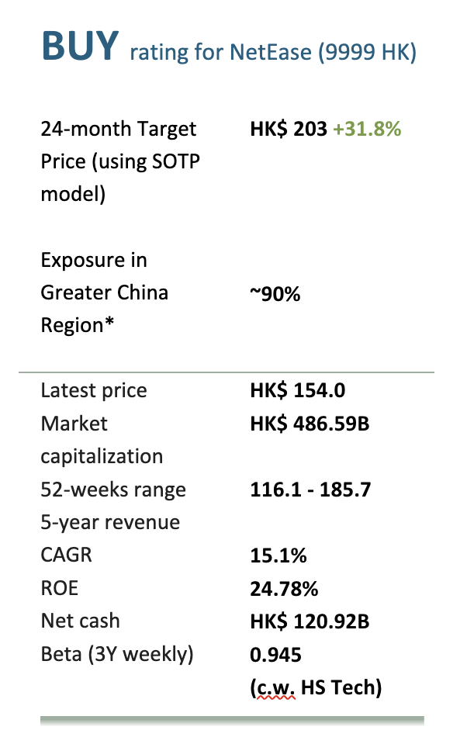
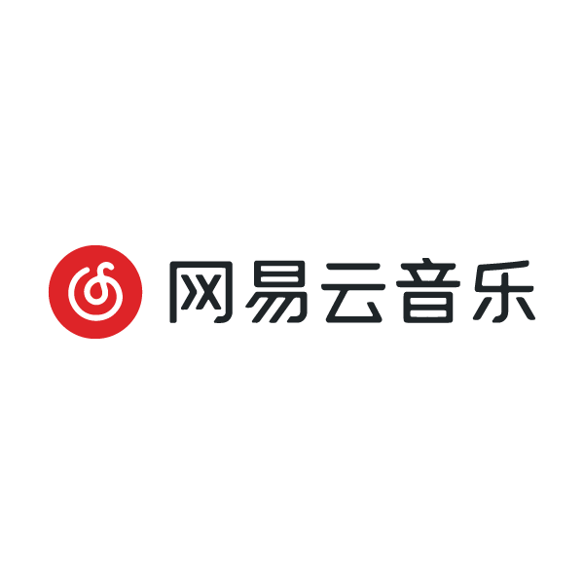





Executive Summary
Key Takeaways
Develop and operate video games on mobile, PC & console
Other businesses: YouDao, Cloud Music, Yanxuan
In 2023: Net profit increase 41.8% YoY to HKD $32.51B
Business
Lines
Key Takeaways
From 2018-2027E:
Global Gamers: 826M 1.47B (+78%)
ARPU: CAGR 5.2%​
Steady Expanding Market
NetEase expected oversea games revenue CAGR: c.24% from 2022 to 2025F*
Global Gaming Factory ​​
Good and Generous
Management
Dividend yield: 2.81% in 2023, 27% Net Income used to repurchase in last 2 years
Solid Financial Foundations​
Free cash flow: 31.1B in 2023, Ending Cash Balance CAGR: 21.9% from FY22 to FY26F
Figure: Key Financial Figures
Updated on 9 May, 2024
* DBS Estimate 2023
Notes:
Good afternoon judges, we are team 39
Let's start with a brief recap on executive summary of the company NetEase.
DAO: online learning platform
Yanxuan: lifestyle brand
24-month TP: HKD$ 203 (31.8% upside)
Why we like NetEase? 4 reasons

Slide 3
Investment Philosophy
Investment Philosophy
We look for...
We would prefer...
We would avoid...
Robust Growth at Fair Price Seeking companies where intrinsic value surpasses the current market price.
Sustainable, Predictable Growth
Prioritizing companies with steady growth not dependent on isolated projects.
Financial Strength
Focusing on companies with a consistent record of positive free cash flow and solid financial practices.
Growth Industries and Scalability Companies in growing sectors with scalable business models.
Stable Management and Strong Culture
Emphasizing the importance of stable management and a culture focused on long-term sustainability.
Transparent Corporate Structure Preferring companies with simple, clear shareholding structures to avoid agency conflicts.
Competitive Advantage (moat)
Seeking businesses with a unique selling proposition or a strong competitive edge.
High Uncertainties and Risks Avoiding companies with significant geopolitical risks or high levels of debt.
Dependency Risks
Steering clear of companies overly reliant on a single customer or supplier.
Harmful Business Practices Avoiding companies that engage in reckless expansion, neglect minority shareholders, or have complex cross-holding structures that obscure management accountability.
Notes:
When we are determining what stocks to pick, there is several key factors we take into account:
There's some factors that is a plus for us,
We would try to avoid, as these factors pose instability to the stock price

Slide 4
Why Gaming?

Slide 5
Why Gaming?
Unbeatable Business Model
The gaming sector consistently exhibits robust growth and presents numerous opportunities. Video games have become an integral component of both entertainment and social engagement. According to data from Statista, the gaming industry's revenue is projected to increase approximately 10% annually for the next 5 years.
Steady Growth
Game development is a highly profitable business. Our comprehensive data analysis frequently reveals top game developers showcasing strong financial performance with notable margins. For instance, it's not uncommon to observe gross, operating, and net margins surpassing 50%, 30%, and 20% respectively.
Lucrative
The scalable nature of games, similar to software, allows for easy replication. After the initial development cost, millions of copies can be sold without significant follow-up investment. Minecraft, the world's best-selling game, exemplifies this with over 300M copies sold. (~USD $3B in total)
Scalable
The World Health Organization's inclusion of gaming disorder in its 11th revision of the International Classification of Diseases underscores the high level of user engagement with video games. While addiction is detrimental, this fact illustrates the extent of user attachment to games as a form of entertainment.
Addictive
* Reference: Statista
Notes:
We identify 4 features of game development that we make it a fantastic business model
Stable and grow steadily: game industry revenue increase by 10% annually next 5 years
Very lucrative: we can see companies with gross operating and net margins surpassing 50%, 30% and 20%
Scalable like software: no upper limit
High Addictive: gaming disorder is an addiction, shown gaming can make people play consistently

Slide 6
Why NetEase?

Slide 7


How Game Company Operates?
Scale Matters
Success in content industries like gaming and film can be unpredictable, regardless of investment, and sometimes hardly rationalized.
Company
Business, Operation & Infrastructure
Gaming Industry | Film Industry
Diverse game styles cater to a wide audience, but market reactions can veer unexpectedly. | Multiple themes in films and series cater to a wide audience, but their success can be erratic.
High investment doesn't guarantee success. Conversely, games developed on a lean budget can achieve immense popularity, e.g. Flappy Bird or Candy Crush. | High-cost films featuring famous stars and fancy CG may not necessarily yield high sales, while low-budget films can unexpectedly become blockbusters.
To mitigate the uncertain nature of success in this industry, game companies invest in diversified portfolios, such as mobile and PC games of various themes and styles. | Film companies manage unpredictability by diversifying their portfolios, such as Disney's acquisition of Marvel.
Studios
Each studio specializes in one or several product lines
Generally, large-scale gaming companies experience more stable returns as they don't rely solely on the success of a single title or studio. Acquiring smaller, talented teams and studios facing financial difficulties provides them with an advantageous position.
Notes:
When we look at how game company operates, we realize there are many similarities to content industries. For example, the film industry
There are many studios that specialize in one or several themes or styles, and the company provides them with the business and operation support as well as the infrastructure they need.
Success in content industries like games and films can be hard to predict, and sometimes hardly rationalized.
Very simple games like candy crush and flappy bird can turn out to be great success. So, it is really hard to foresee whether one single title can perform well.
Therefore, the larger the scale of the company that operate more studios of different themes, they usually yield more stable return and possess greater economy scale, translating into higher efficiency and profit margins.

Slide 8
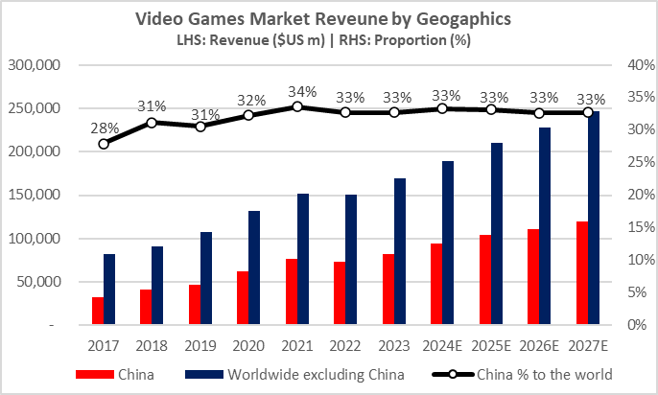
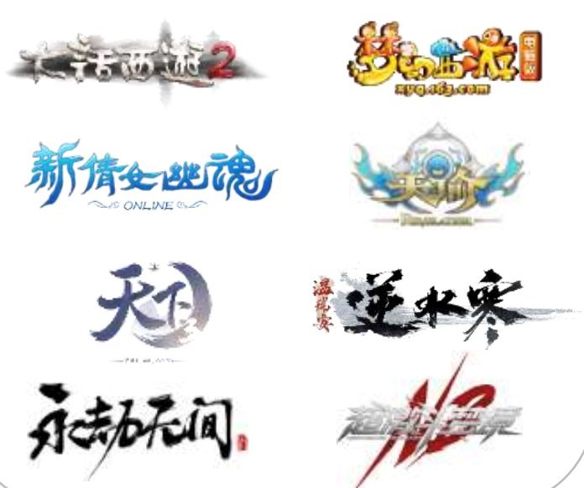

What NetEase is special about?
Accessibility to China Market
NetEase, as a Chinese company, holds a significant advantage.
Even with slowed growth, China remains the largest and most profitable market globally, contributing to 1/3 of the worldwide revenue.
The Chinese market, however, presents unique challenges due to regulatory hurdles and distinct cultural preferences.
Regulation
Culture
Entry into China's gaming market is notoriously challenging due to stringent licensing and publication restriction.
The Chinese gaming market is deeply influenced by local themes, such as Chinese literature classics.
These market barriers allow NetEase to leverage the vast Chinese market, which is the primary source of its revenue and profit.
Notes:
One of the biggest advantage of NetEase is that it can access the China market.
Even if game revenue growth has slowed down in China, it is still the largest market in world, accounting for almost one third of total worldwide.
However, regulation and cultural differences post huge barriers for foreign game company to enter China.
For example, overseas company maybe hard to get the publication permission from the authority.
And culture-wise, Chinese games prefer games with China element that is hardly replicated. As a result, most of the foreign games have to be imported by local game companies like Tencent or NetEase.
The barrier provides NetEase and other Chinese game companies exclusive access to China market.

Slide 9

What NetEase is special about?
Management and Corporate Culture
Flat Management
Dare to be slow
NetEase practices a flat management structure, encouraging junior employees to voice their opinions to managers and participate in decision-making.
Product managers are given autonomy to focus on product development before considering monetization and profitability.
NetEase takes a conservative approach, refraining from rapid, cash-intensive growth strategies. They avoid homogenization and focus on product differentiation, e.g. Cloud Music, Koala.
They often opt for creating their own solutions rather than pursuing M&A, e.g., developing their own game engines instead of third-party solutions.
Description
This structure allows NetEase to readily adapt to market trends and consumer behaviors, e.g. NetEase was initially set up to be “China’s Yahoo”, but soon it turned to focus on pc games and later it also seized the opportunity of mobile platforms.
It fosters an environment where innovative ideas can be explored and implemented, sometimes leading to unexpected successes. For example, ”Eggy Party” was thought to be a mediocre game but turned out to be great success.
The conservatism within NetEase assures investors its commitment to balance growth and inputs. Although the same conservatism makes NetEase miss out many opportunities in China Internet boom, e.g. food takeout, ecommerce, etc. It ensures shareholders are rewarded.
NetEase returns its most of its free cash flow shareholders through dividend and buyback and requires no external funding for a long time. It ensures that shareholder can be truly rewarded from their investment.
Benefit
Notes:
NetEase’s management and corporate culture are also the reasons that make NetEase stands out.
It is well known that NetEase adopts a flat management hierarchy and employees are given autonomy to explore what they think suitable.
This allows NetEase to react to market changes swiftly. It is especially important in such a creativity intensive industry.
In fact, from the development of NetEase, we can see it successfully captured the change in market landscape.
The recently released Eggy Party that become a great hit in China is also the result of the freedom given to employees to explore.
The other DNA of NetEase’s corporate culture differentiate it from other China internet companies. It dares to act slowly.
NetEase has been very reluctant to launch cash burning war to win over its counterpart to seize market. Instead, it tends to create differentiation in its product to stand out.
One good example is Cloud Music. NetEase emphasizes more on building community and supporting young music producers than paying high premium for copyrights.
This conservatism makes NetEase maintain good financial discipline and able to reward to shareholders continuously.

Slide 10
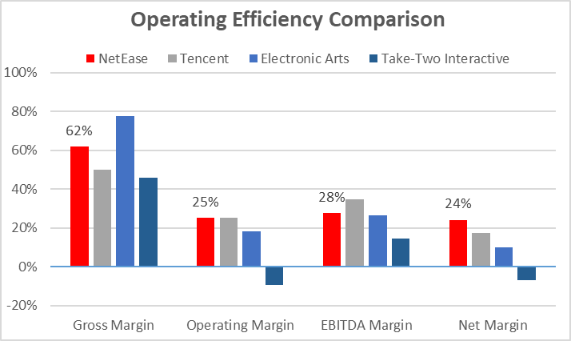
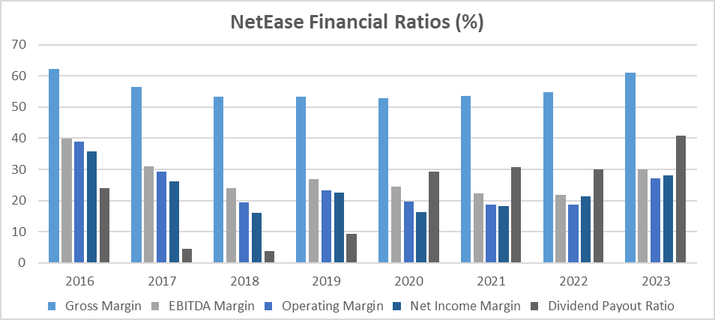
Why NetEase is better than its peers?
Operation Efficiency
NetEase boasts a consistently high and stable margin ratio among global counterparts, a testament to its effective resource allocation and cost management.
Key contributors to NetEase's operational efficiency include:
Proprietary tools and supports that streamlines development
Economies of scale from studio sharing common infrastructure
Prudent resource allocation by management
Flat management style and corporate culture
Investments in Cloud Music, Koala, Yanxuan, Youdao and other businesses led to a temporary decrease in margin ratios and dividend payout until 2018. As these investments matured, NetEase’s profitability began to recover. The company has since increased its dividend payout ratio, returning excess cash to shareholders.
Notes:
As a result of NetEase’s management style and corporate culture, NetEase has shown its high operation efficiency.
Among its peers like Tencent, EA and Take-Two interactive, NetEase has performed quite well in terms of profit margins.
It shows that NetEase’s is very cost efficient on its operation. We identify 4 reasons for NetEase’s high efficiency
Proprietary tools and supports that streamlines development
Economies of scale from studio sharing common infrastructure
Prudent resource allocation by management
Flat management style and corporate culture
In fact, since 2018, NetEase’s profit margins have been gradually increasing. This is because of lower investments into other businesses and Alibaba acquiring Koala.
With lower fund requirement for investment, NetEase returns more of its cash to shareholders as you can see the payout ratio has been increasing.
We believe NetEase will continue the trend to pay more dividend and do more buyback.

Slide 11
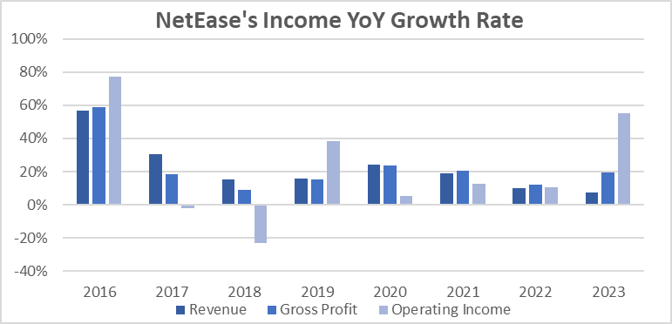

Why NetEase is better than its peers?
Cheap Valuation
 | NetEase | Tencent | EA | Take-Two
P/E | 15.18 | 27.54 | 27.86 | N/A
P/S | 4.32 | 5.12 | 4.68 | 4.68
P/FCF | 12.65 | 14.31 | 15.19 | N/A
NetEase's valuation, relative to its global peers, is notably undervalued. This discrepancy can be attributed to both internal and external factors.
Internal
NetEase's revenue growth has slowed down.
External
Escalating tensions between China and the West.
Tighter regulation on gaming in China.
Market selloff of Chinese stocks due to a sluggish economic recovery.
However, all these factors are showing signs of reversal:
There are indications of improving relations between China and the West.
China's economy has shown resilience, despite the real estate crisis.
There has been a relaxation in China's control over game publication.
NetEase's overseas expansion, such as with 'Harry Potter: Magic Awakened,’ is showing promise.
We anticipate the market will ultimately recognize and value NetEase's ongoing
efforts to improve operational efficiency, correcting its current undervaluation.

Slide 12
Investment Strategy

Slide 13
Investment Strategy
Two Stage Approach
1st stage (24 months): | Capture the rebound of China’s market
2nd stage (24 months onward): | Review investment to see if NetEase’s long-term catalysts are materialized
Short-term Catalyst
Long-term Catalysts
Rebound of China market and multiple recovery
Capital Structure Optimization
Inclusion in China-Hong Kong Stock Connect
NetEase’s overseas expansion progress
Upside
Based on our valuation model, NetEase has upside of 31.8% to reach fair value (TP: $203)
Downside
We believe NetEase’s stock price is unlikely to be lowered than $84.05, the lowest price during market selloff in October 2022, implying 13.7X P/E at that time.
Margin of Safety: NetEase’s strong financial performance and robust balance sheet
Net cash of HK$ 120 billion | 20+ years of consecutive positive revenue and gross profit growth
Notes:
We recommend a 2 stage approach on investing in NetEase.
The first stage last for 2 years from now. We recommend buying NetEase now to capture the rebound of China’s market
After holding it for 2 years, then we can review whether NetEase long term catalyst are materialized.
Long term catalyst include
Capital structure optimization
Inclusion in China-HK stock connect scheme
Overseas expansion
Upside: 31.8% based on our target price. It is our baseline estimation and we believe it is rather conservative
Downside: we don’t think it can get any cheaper than when it was October 2022. At that time, it was traded at 13.7 times PE. We think it can hardly be any lower.
Regarding the margin of safety, the biggest safety comes from NetEase’s robust balance sheet.

Slide 14
Risk Factors

Slide 15





Risk Factors
Politics and Competition
International
Domestic
Competition
Geopolitical Tension between China and the West
Uncertainties persist regarding future policies as a result of the U.S. Presidential election in November. Possible scenarios include mandatory divestment from Chinese companies and prohibitions restricting Chinese companies' access to the U.S. market.
China Government Policy on Gaming
The Chinese government may extend its current restrictions on game publication and limiting the gaming hours for minors. In fact, since 2021, minors can only play 1 hour per day on weekend.
The Rise of Short Videos as a Competitor
Video games, as a form of entertainment, face competition from short video platforms like TikTok. This shift in consumer attention could potentially result in decreased demand for video games, much like the impact of streaming platforms on traditional cinemas.
Notes:
There is 3 major sources of risks:
International-wise
Geopolitical risk between US and Chinese govt, esp. NetEase is listed in US market as a Chinese company
Internally, from Chinese govt, extend restrictions on game publication and limit gaming Geopolitical Tension between China and the West
Uncertainties persist regarding future policies as a result of the U.S.
Presidential election in November. Possible scenarios include
Mandatory divestment from Chinese companies and
Prohibitions restricting Chinese companies' access to the U.S. market.
China Government Policy on Gaming
The Chinese government may
Extend its current restrictions on game publication
Further limit the gaming hours for minors.
In fact, since 2021, minors can only play 1 hour per day on weekends.

Slide 16
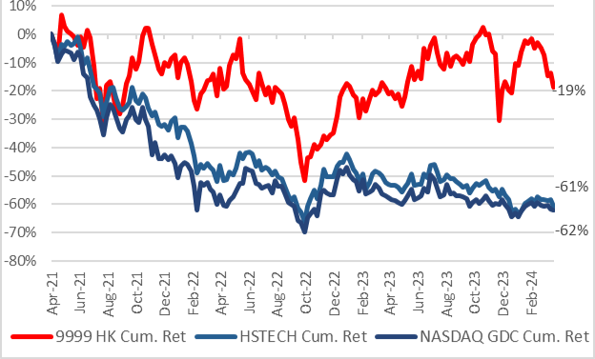
Relevant data
Appendix
Fig 0: NetEase stock price performance versus benchmark

Slide 17
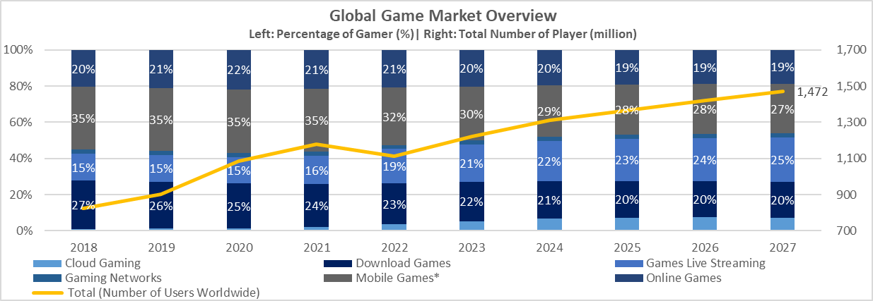
Relevant data
Appendix
Fig 1: Distribution of different types of gaming
Source: Statista

Slide 18
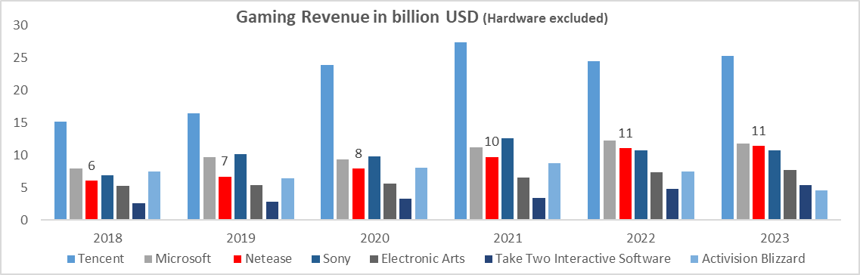
Relevant data
Appendix
Fig 2: Game Sector revenue of the biggest market players
Source: Bloomberg

Slide 19
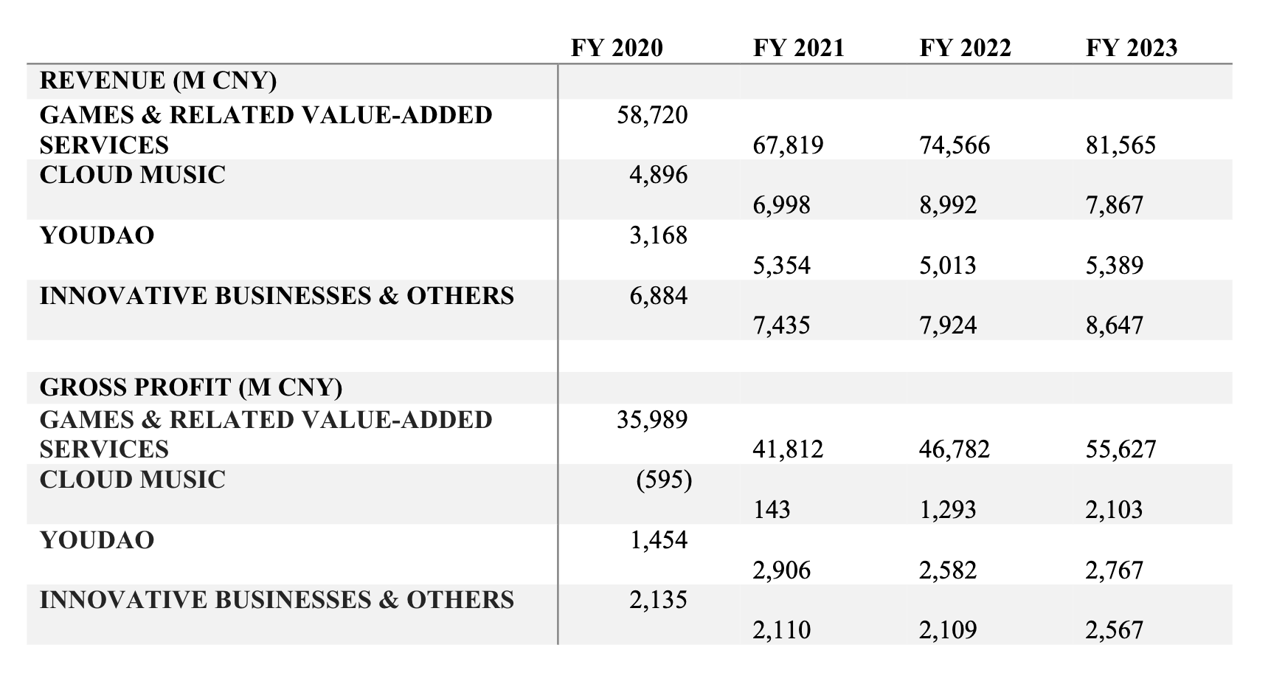
Relevant data
Appendix
Fig 3: Revenue breakdown of NetEase

Slide 20
Relevant data
Appendix
Name | Position | Time at NetEase
丁磊 | CEO | 1997 - Present
楊昭烜 | CFO | 2017 - Present
胡志鵬 | VP, 雷火事業群PIC | 2007 - Present
周枫 | SVP, Youdao CEO | 2004 - Present
Fig 4: NetEase shareholding structure

Slide 21
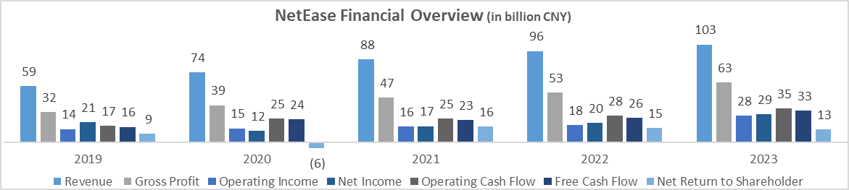
Relevant data
Appendix
Fig 5: Financial Overview of NetEase

Slide 22
Relevant data
Appendix
FY 2023 (in m CNY) | Cloud Music | TME
Revenue | 7,867 | 27,752
Gross Profit | 2,102 | 9,795
Net Profit | 734 | 4,920
Fig 6: Revenue of Cloud Music versus Tencent Music Entertainment (TME)

Slide 23
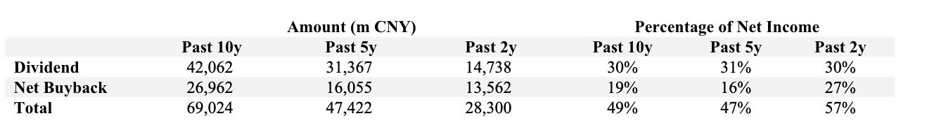
Relevant data
Appendix
Fig 7: NetEase Dividend Payout and Net Buyback

Slide 24
Relevant data
Appendix
 | VALUATION (USDMN) | STAKE | ATTRIBUTABLE VALUATION (USDMN) | VALUATION METHODOLOGY
ONLINE GAMES | 67,904 | 100% | 67,904 | 18 * FY24F P/E²
CLOUD MUSIC | 2,393 | 61% | 1,460 | Market Value³
NETEASE YOUDAO | 443 | 59% | 261 | Market Value
GROSS EV |  |  | 70,299
HOLDING DISCOUNT⁴ |  |  | 30%
NET EV |  |  | 69,782
NET CASH |  |  | 15,755
MARKET CAP |  |  | 85,537
TOTAL OUTSTANDING SHARES (M) |  |  | 3,301
TP (HKD) |  |  | 203
Fig 8: NetEase – SOTP Valuation model

Slide 25
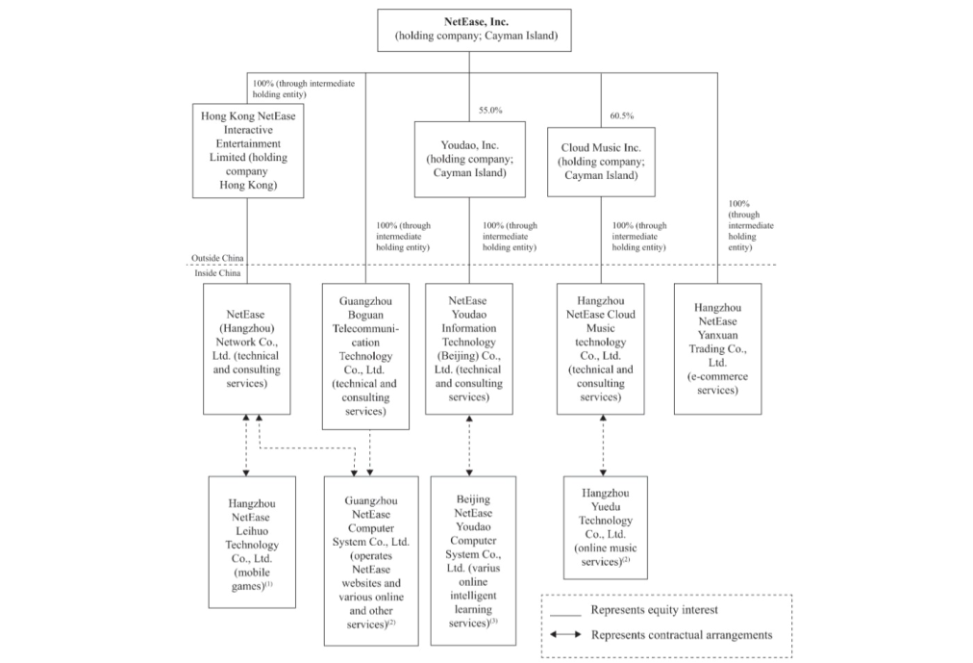
Relevant data
Appendix
Fig 8: NetEase Shareholding Structure

Slide 26
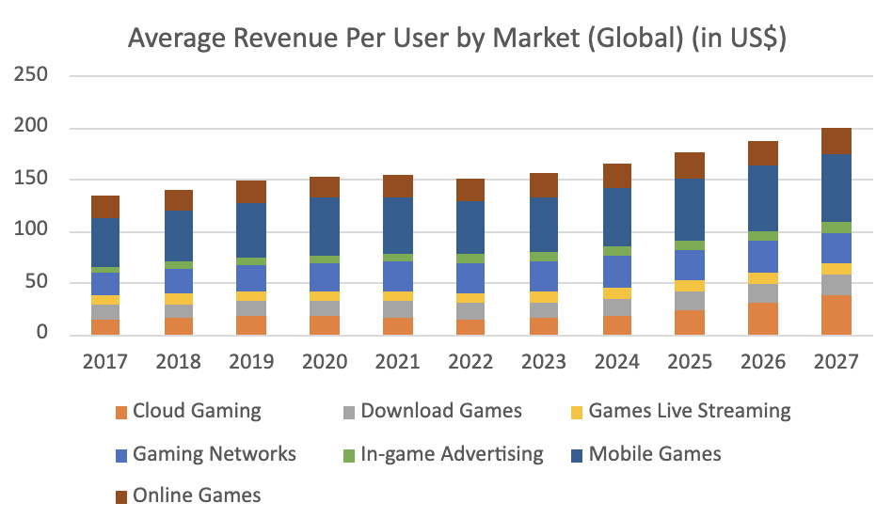
Relevant data
Appendix
Fig 9: Average Revenue Per User by Market (Global)

Slide 27
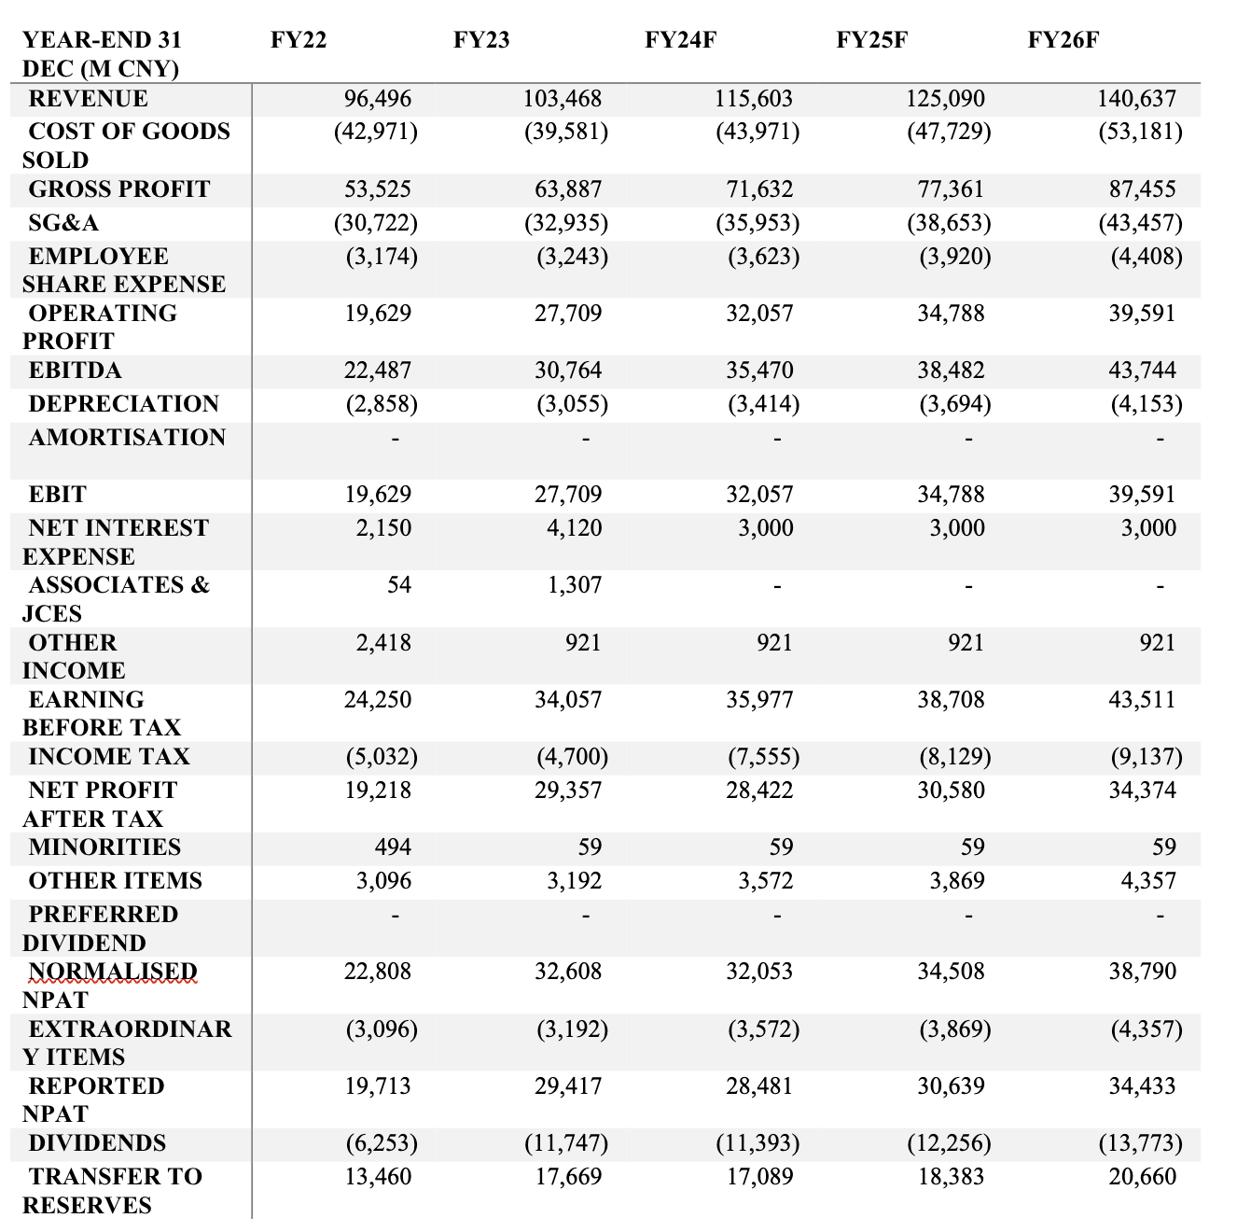
Relevant data
Appendix
Fig 10: Forecasted Income Statement

Slide 28
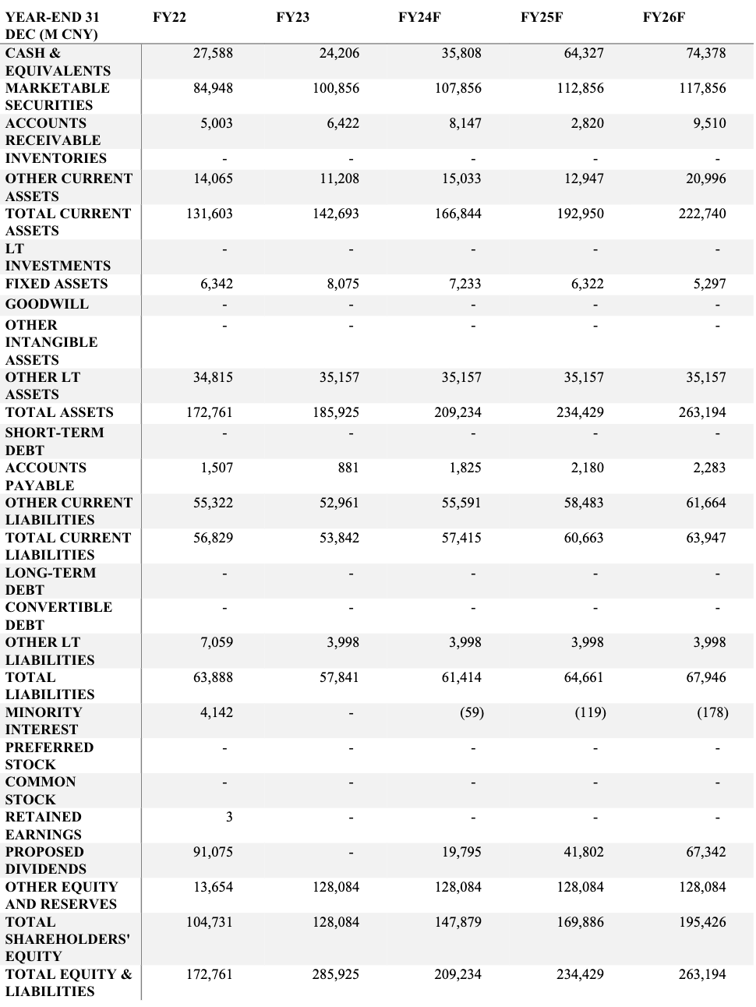
Relevant data
Appendix
Fig 11: Balance Sheet

Slide 29
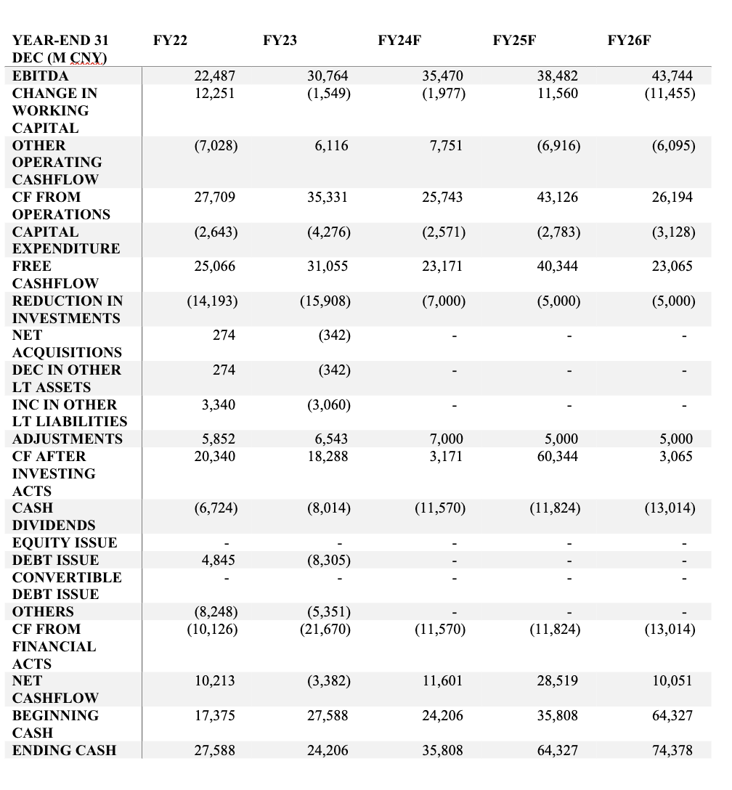
Relevant data
Appendix
Fig 12: Forecasted Cash Flow Statement

Slide 30
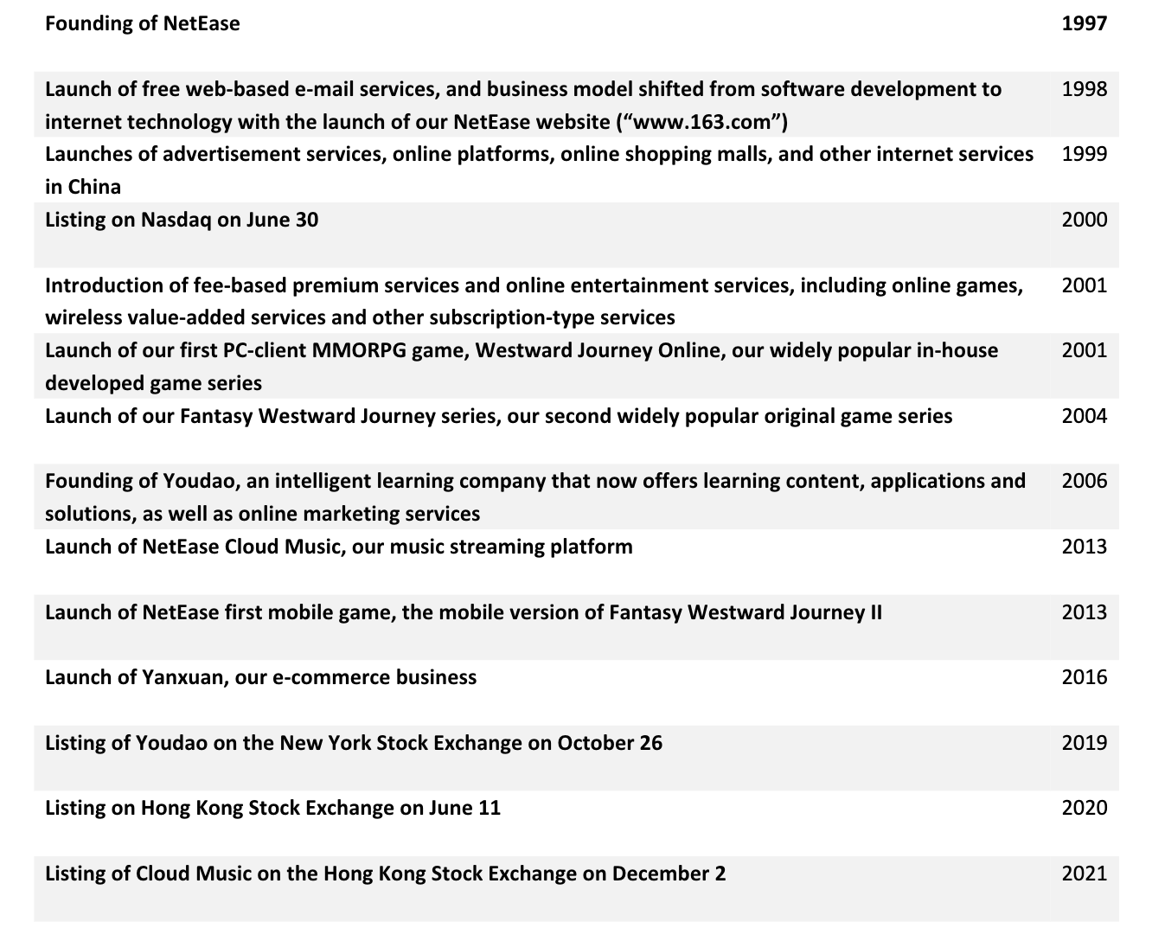
Relevant data
Appendix
Fig 13: Company Milestone

Slide 31
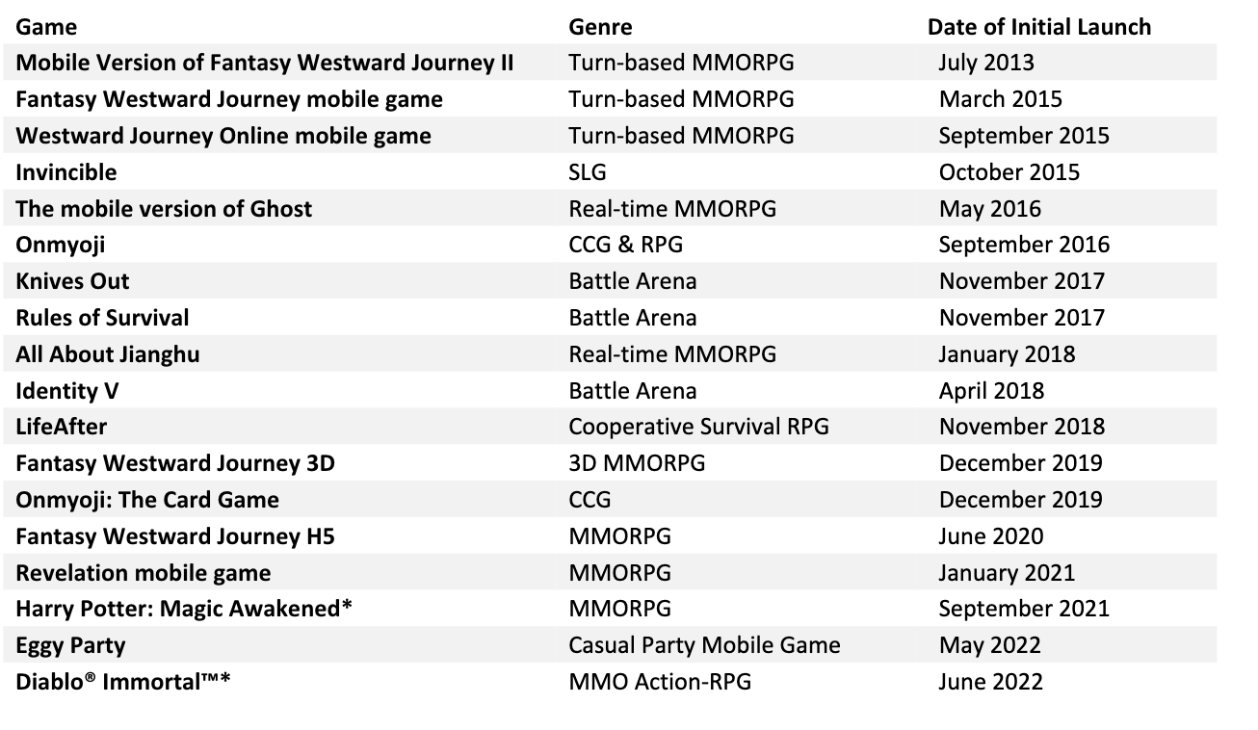
Relevant data
Appendix
Fig 14: List of in-house mobile games

Slide 32
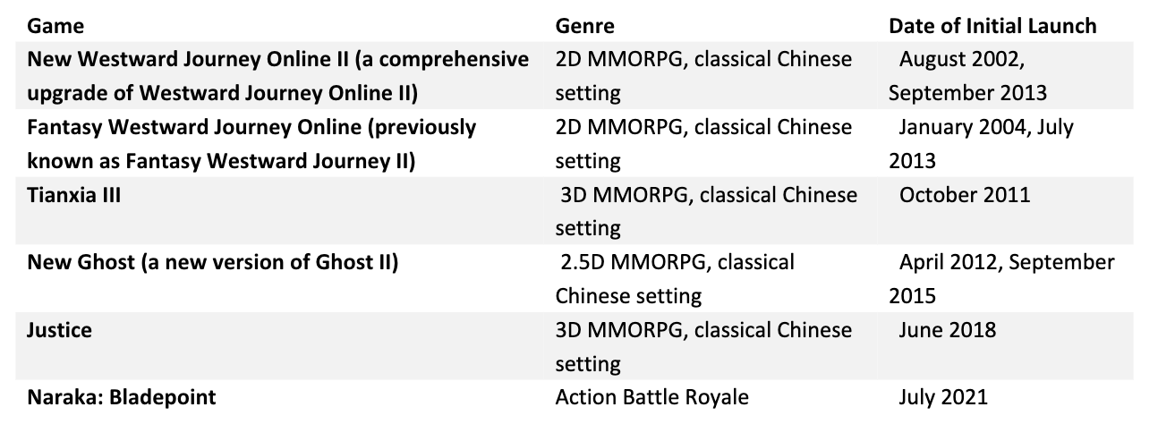
Relevant data
Appendix
Fig 15: List of in-house PC & console games

